Slide 1
Terminal
Expense
Tracker
7/2/2025
Avraham Felzenstein

Slide 2
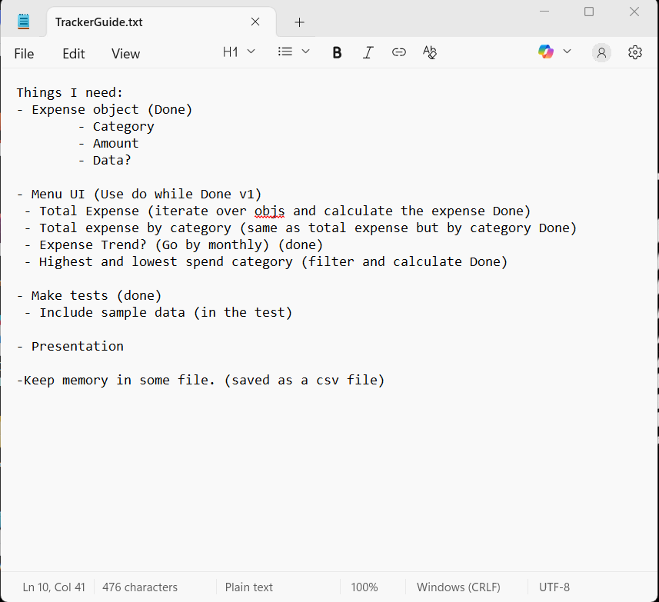
Part 1a: My Approach
My approach to the project was by first taking the requirements and segmenting them into lists of what I would need per requirement
I went with mapping the expense object first since I knew that it would be the crux of the entire project
Afterwards, I mapped out the Menu
UI, the functions that would be in it and a short “how I would make it”
Finally I listed what other requirements would be needed
A txt file with my approach

Slide 3
Part 1b: The function design
Both of the main java files have different functions in order to provide a stellar user experience
There is much to go over in terms of how each function works and their purpose
Thus please refer to the readme file for a more in depth discussion of the functions

Slide 4
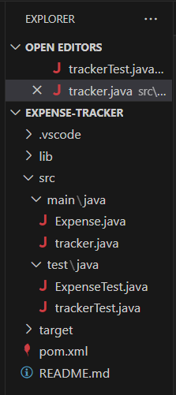
Part 2a: Key files/folders
For the project, I made it using Maven with the VSC ide and Java as the language of choice since that’s my specialty
Expense-tracker is comprised of two java files Expense.java and tracker.java in which Expense held the expense object and key function and tracker had the functions for the tracker UI. Included is a test suite for Expense and tracker respectively
A pom xml file is included as well for holding my dependencies for testing and configurations (Java 17)
My file structure:

Slide 5
Part 2b: quick rundown of file storage
The files are stored in a specific order (see prior slide) due to the restrictions of maven
Furthermore once a user compiles the project, a target folder would be created which would included the compiled files.
A user can have repeated sessions with their stored data as the project supports continuous work after any pauses.

Slide 6
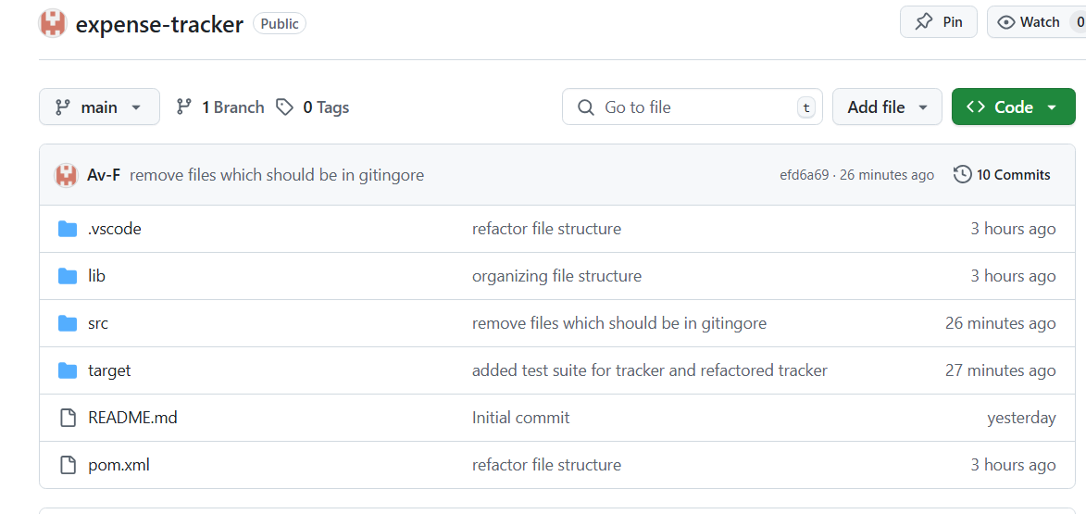
Part 3a: How to run the code
On github, you will first download the repo. Make sure your version of java is java 17.
Then open the folder on terminal by finding the folder location and CD to the path.
Then compile the program with the command > javac tracker.java
Finally run the file with
> java tracker.java
There should be a terminal menu that you can then interact with

Slide 7
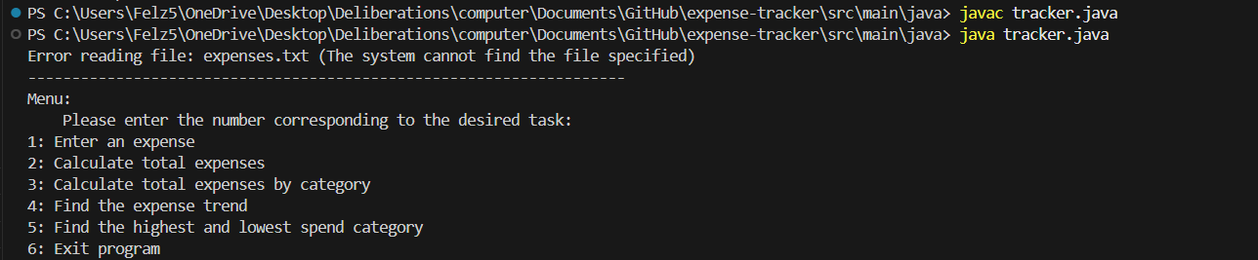
The terminal:

Slide 8
How to operate the program:
Using the options menu shown in the prior slide, type in the number which corresponds to the actions you’d like to take and hit enter.
For inserting an expense, please note that you first input the name of the expense, then the amount. There is no need to put in the $ sign, only the amount. Then finally, the date which is enforced be in a dd-mm-yyyy format.
After you’re done specifying an attribute, hit enter to continue to the next one.
Once you are done, press 6 and enter and the program will finish with your work saved as expense.txt

Slide 9
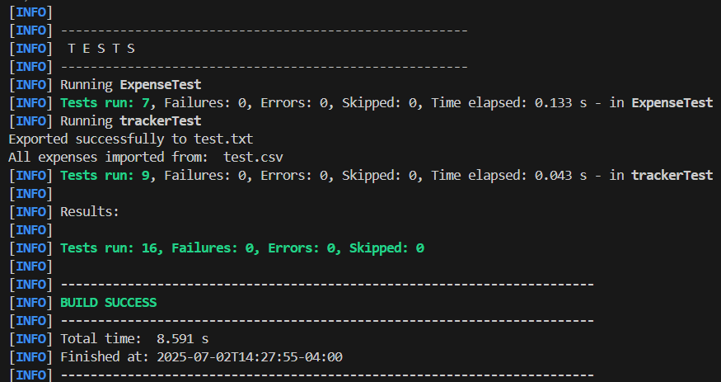
Part 3b: How to test and verify the code
Similar to part 3a, instead of having the path be selected for main/java, you must cd out into the project folder expense-tracker
From there, you can run the command
> mvn test
Each test is designed to test a function in the Expense and tracker files run by jUnit with sample data seeded in.
Example of path to where to run the test suite:

Slide 10
Conclusion:
Overall my expense tracker was able to complete the necessary tasks as described in the project description.
I utilized common programming techniques such as object oriented programming principles and data structure design.
If I had more time, I would have added greater safeguards to ensure each function works such as enforcement of correct selection of tasks to ensure that edge cases are dealt with and possible bugs not found in my previous testing were debugged.
Additionally, I would have dockerized the project so that it’s all wrapped up in a container so sharing the project would have been easier given a containerized environment.

Slide 11
References:
Java Cheat Sheet & Quick Reference
Maven Documentation – Maven
Java Files
Java.io.BufferedReader Class in Java - GeeksforGeeks
Java.io.BufferedWriter class methods in Java - GeeksforGeeks
DSA Hash Maps
JUnit 5 User Guide

